Slide 1
Spatial niche
Rafael D’Andrea
John Wang
James P O’Dwyer

Slide 2
Accuracy increases with the envt grain-to-cell size ratio
Smaller cells relative to envt grain is better

Slide 3
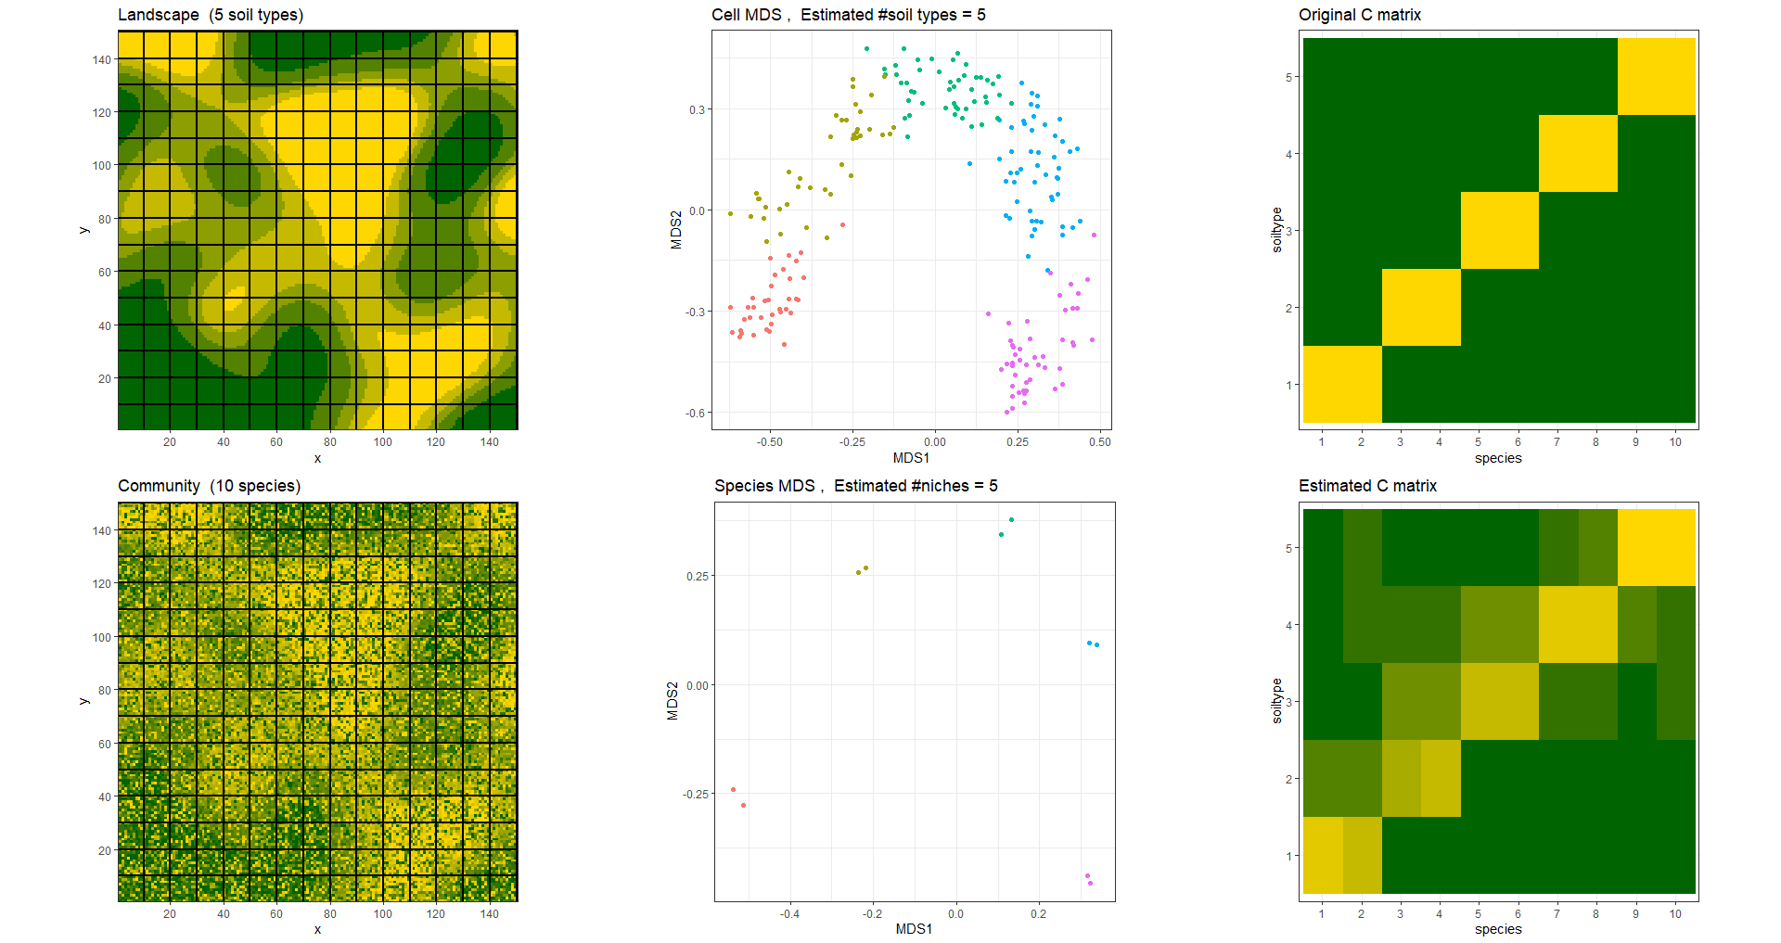
22.5k sites
225 cells
5 soil types
10 species

Slide 4
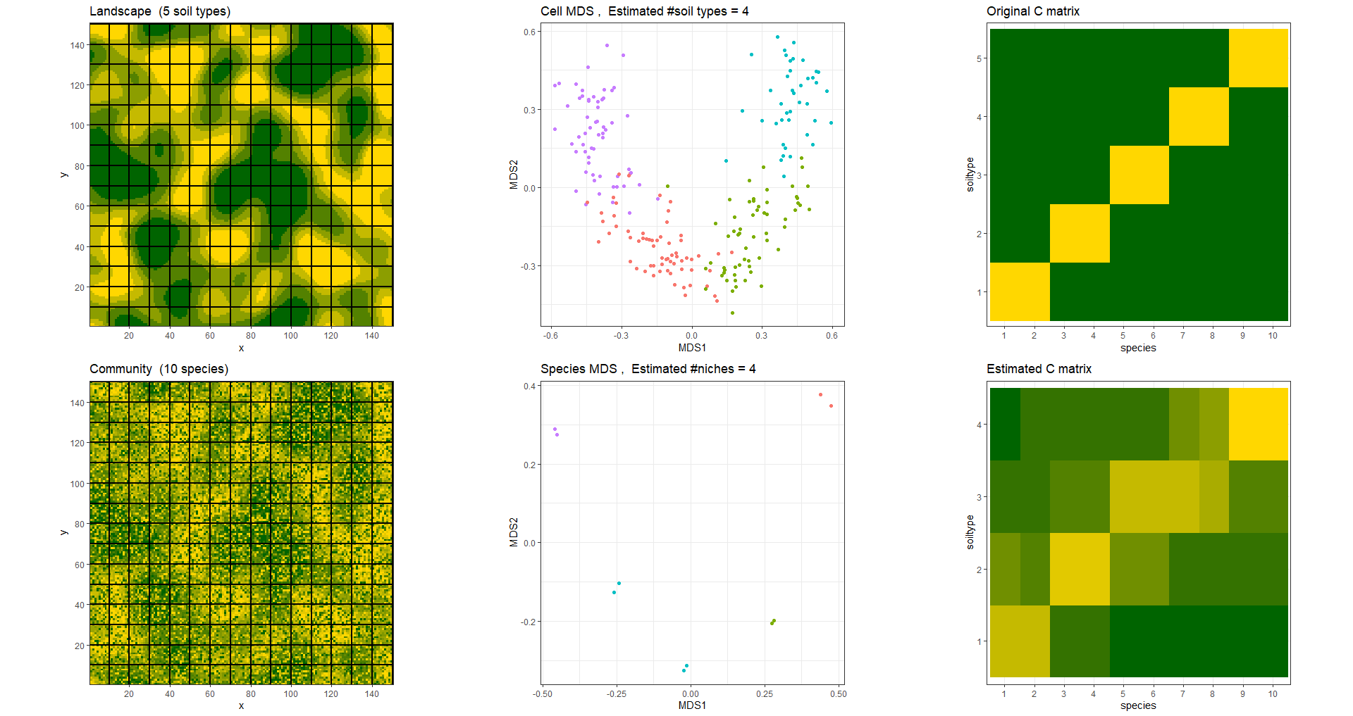
22.5k sites
225 cells
5 soil types
10 species

Slide 5
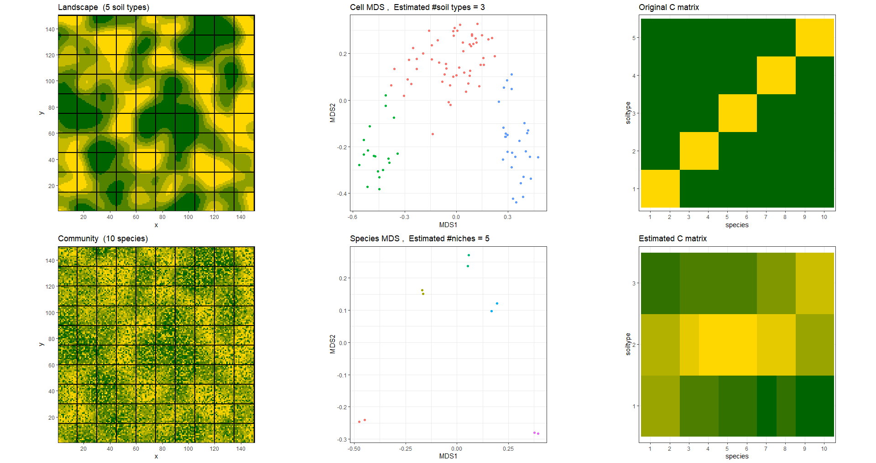
22.5k sites
100 cells
5 soil types
10 species

Slide 6
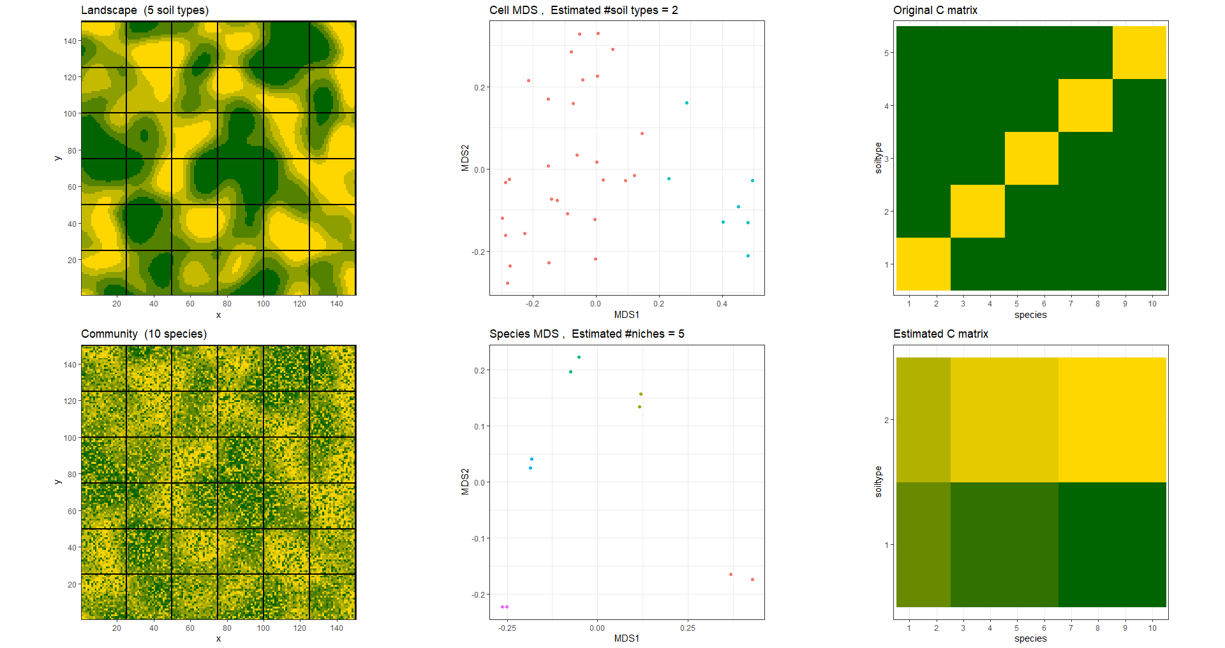
22.5k sites
25 cells
5 soil types
10 species

Slide 7
Accuracy decreases with the number of soil types and/or species
More soil types or more species is worse

Slide 8
22.5k sites
225 cells
5 soil types
10 species

Slide 9
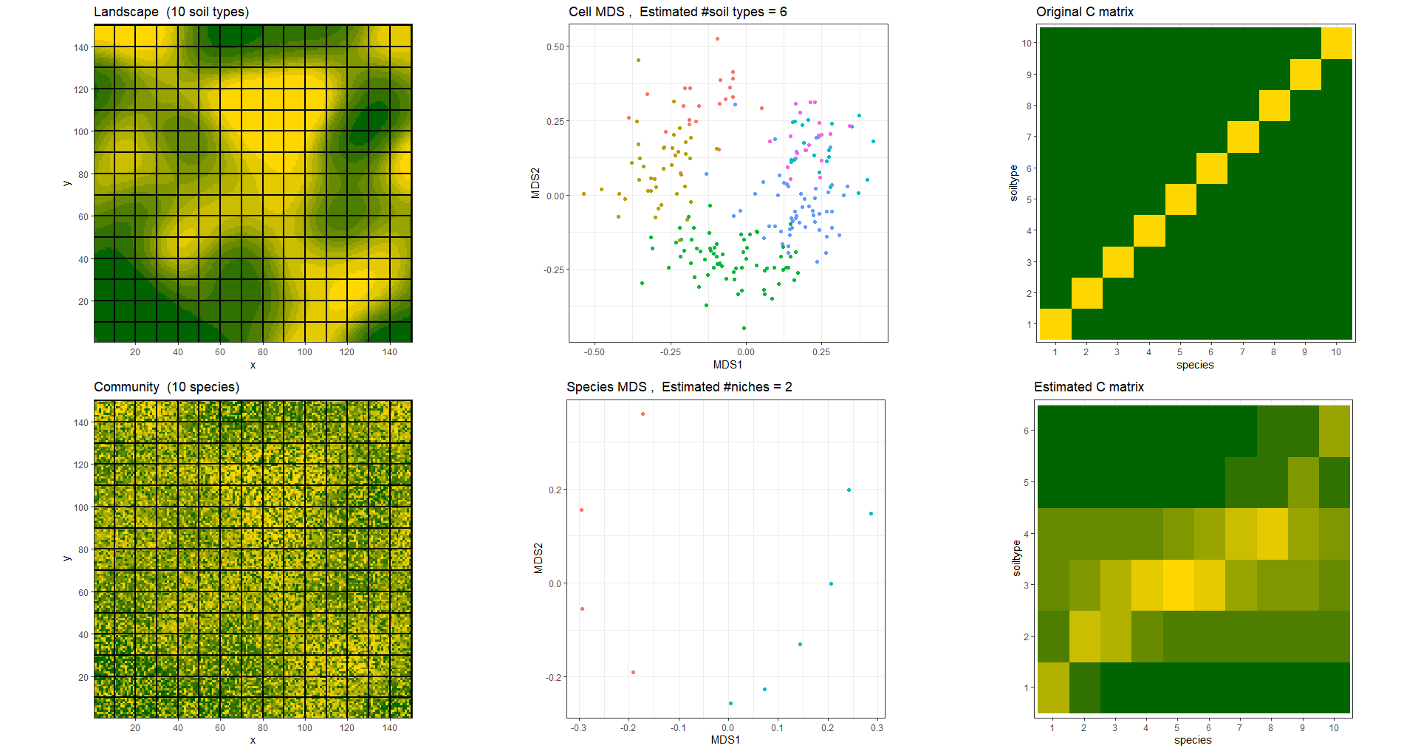
22.5k sites
225 cells
10 soil types
10 species

Slide 10
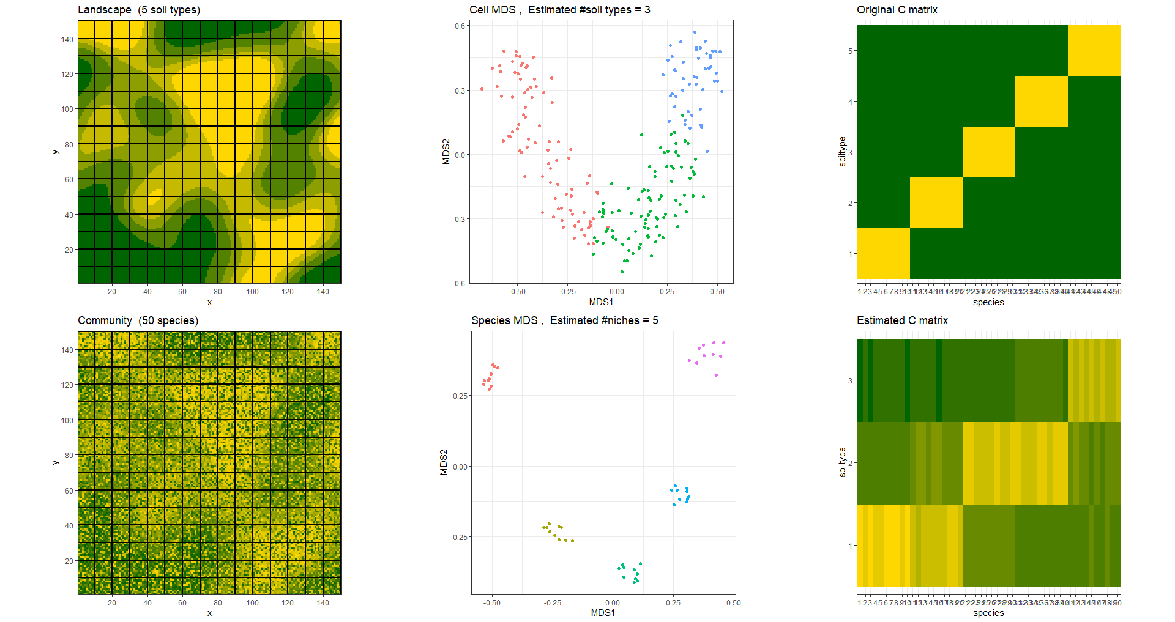
22.5k sites
225 cells
5 soil types
50 species

Slide 11
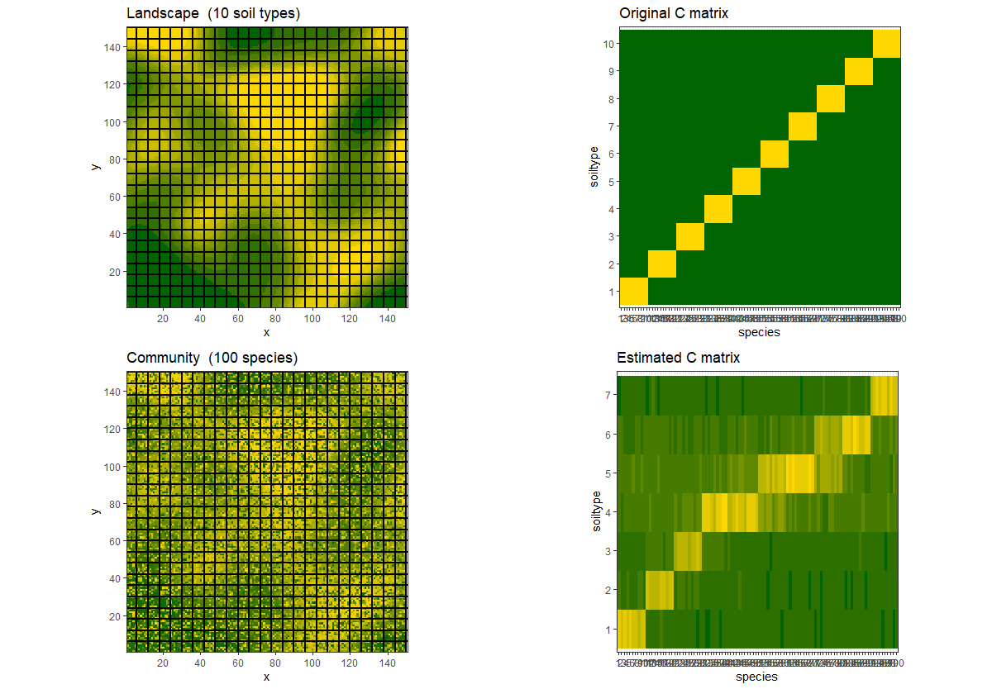
22.5k sites
625 cells
10 soil types
100 species

Slide 12
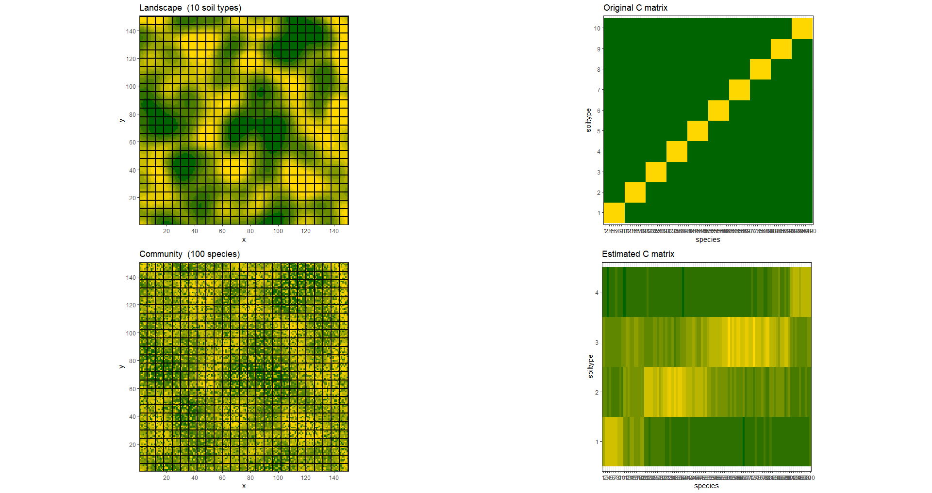

Slide 13
